Slide 1
Solar Energy in Denmark
FinalProject 8
Shakir Maytham Shaker
Magnus Mac Doberenz
Yili Ge
Notes:
This is the final project 8. We plan to illustrate a topic about solar enery in denmark

Slide 2
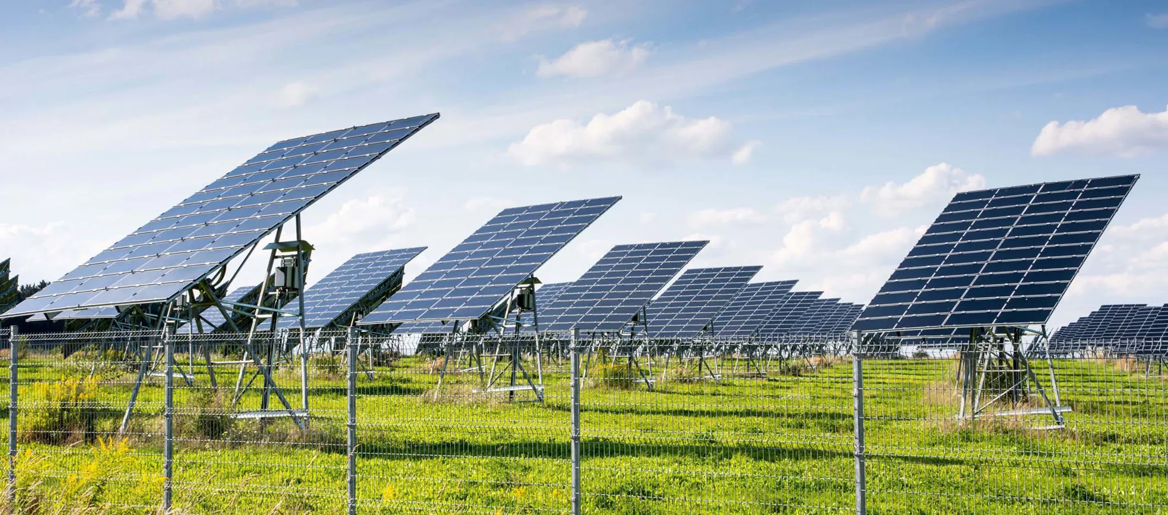
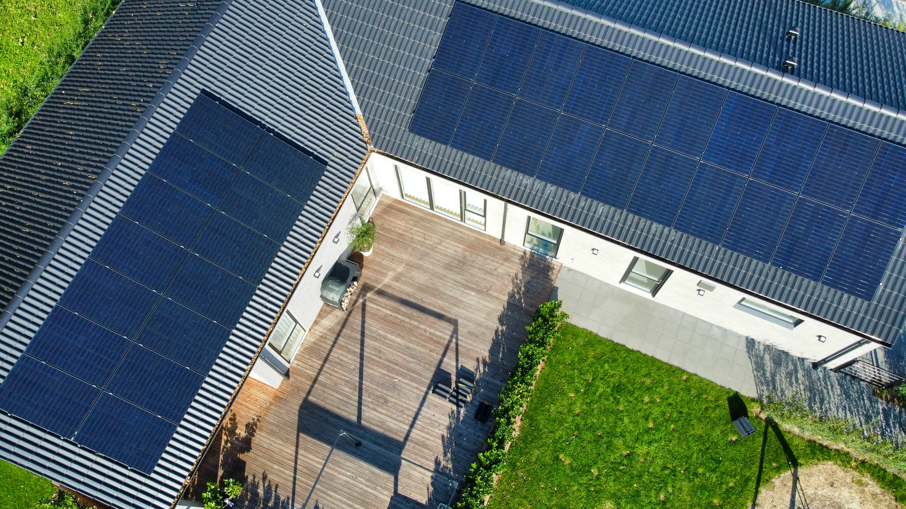
Central Idea
Energy consumption & production at a household level
Sustainability Impact
Economic Analysis
Notes:
20s.
The central idea of this project is to analyze household energy dynamics. From our opinion, analyze the related data could help understanding and projecting future trends and provides insights into the economic benefits of investing in solar energy. The findings could promote in shaping policies regarding energy production, consumption, incentives for solar energy, and grid reliance.

Slide 3
Dataset
Source: EasyGreen.dk
Table:
Size | 64 MB
Rows | 396 k
Variables | 15
Date Range | 2022/11 ~ 2024/03
Description:
Core features: UsePower, ProductPower, SelfUsePower, BuyPower
Genre: Annotated Chart & Partitioned Poster
Notes:
30s.
The dataset is from EasyGreen company.
The number of rows is around 396k from the period of 2022 to 2024.
It contains the solar consumptions and productions and the usage from grid.
So, For such a topic, the annotated chart and partitioned poster genres might be particularly suitable for showing dynamic comparisons between solar power generation and household consumption in different analytical perspectives.

Slide 4
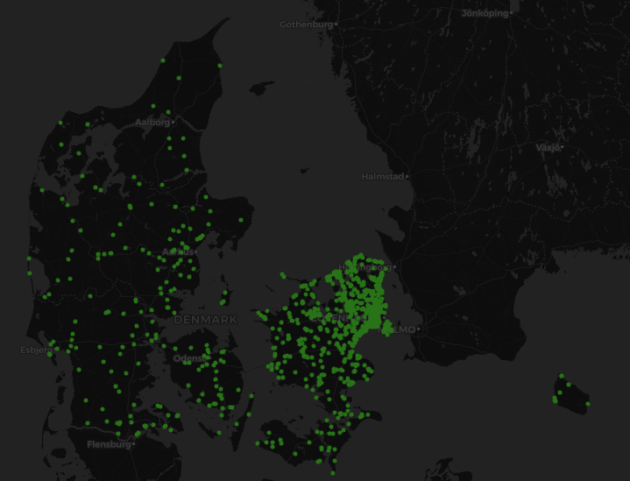
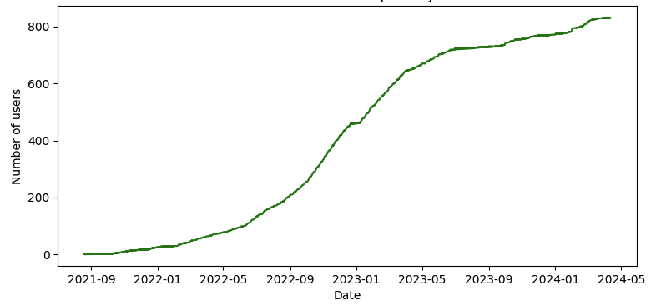
Mockup
Distribution of solar panel installation
Number of Users per Day
Notes:
15s.
So, for some preliminary analysis, we could provides such plots like a map about solar panel distribution or a flow chart about users increasement.

